Slide 1
TELECOM CHURN CASE STUDY
PRESENTED BY
SAKSHI BHASIN
RUCHI
RUCHIRA
DS C54
BUSINESS ANALYTICS

Slide 2
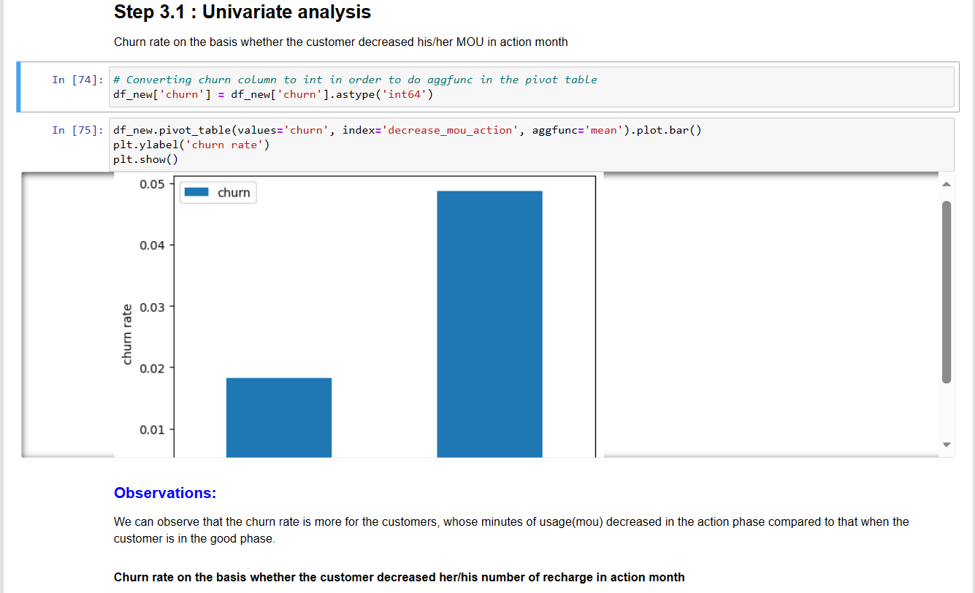
EDA Analysis

Slide 3
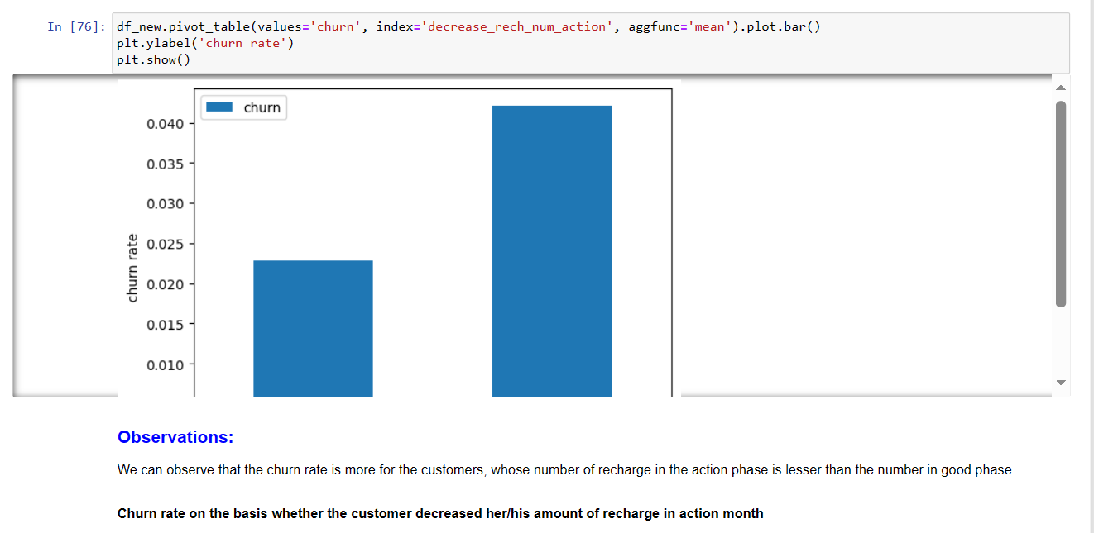

Slide 4
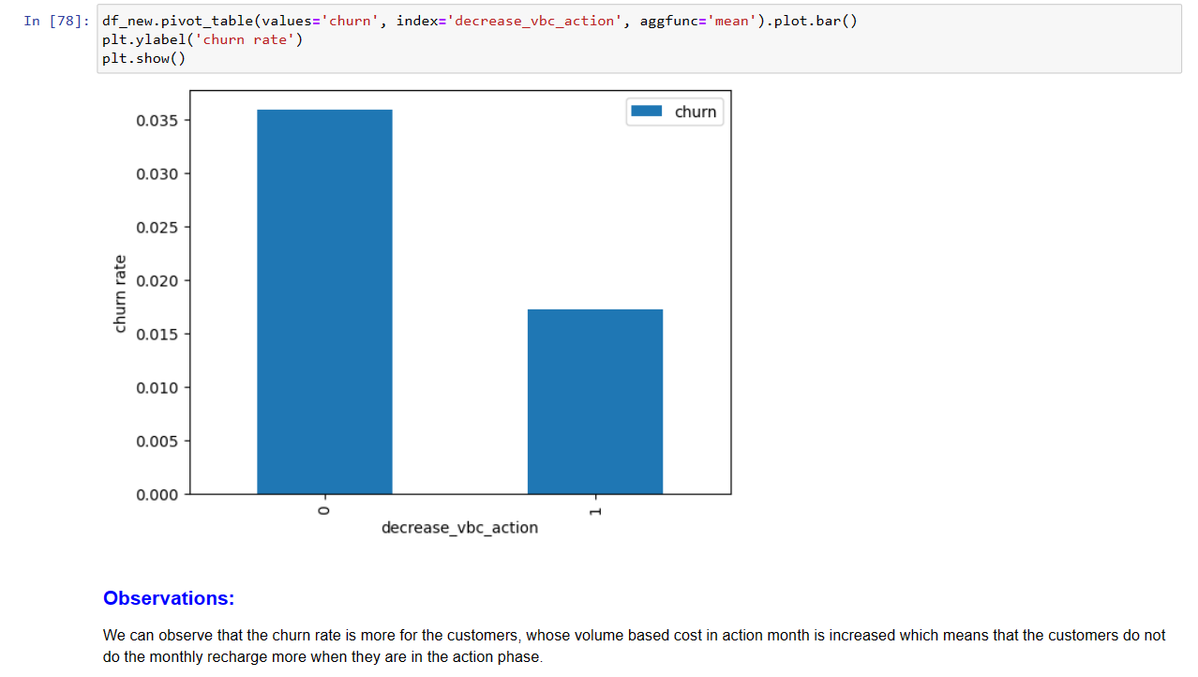

Slide 5
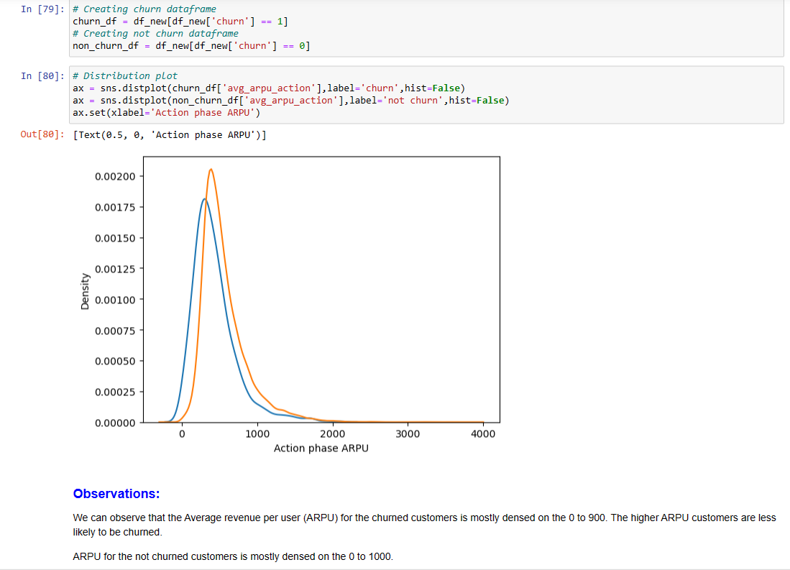

Slide 7
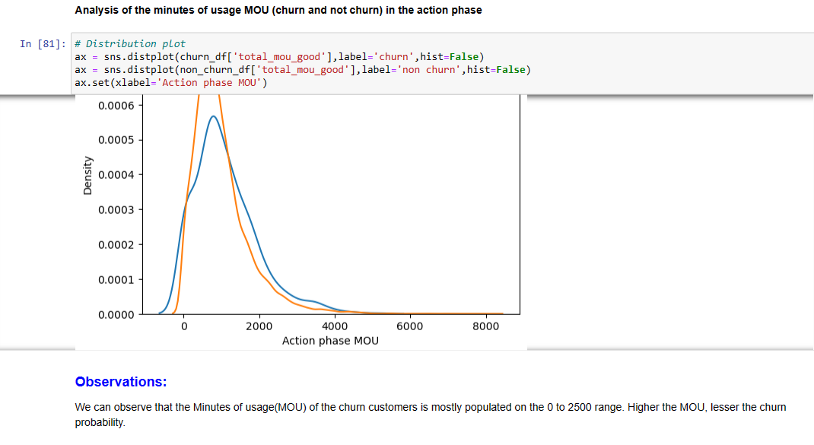

Slide 8
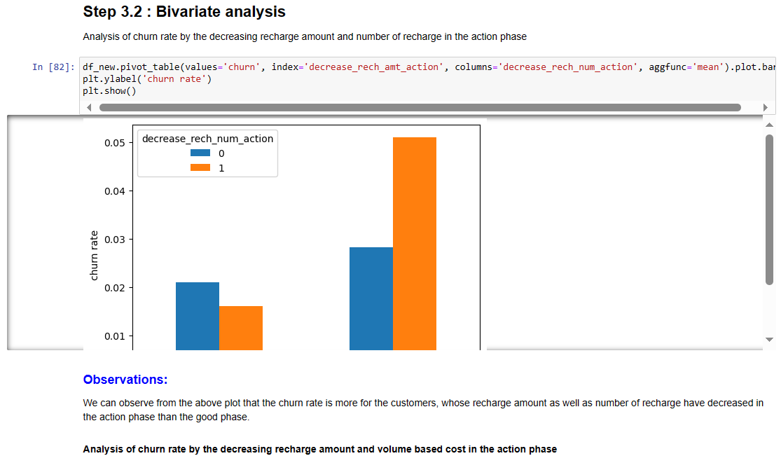
Step 3.2 : Bivariate analysis

Slide 9
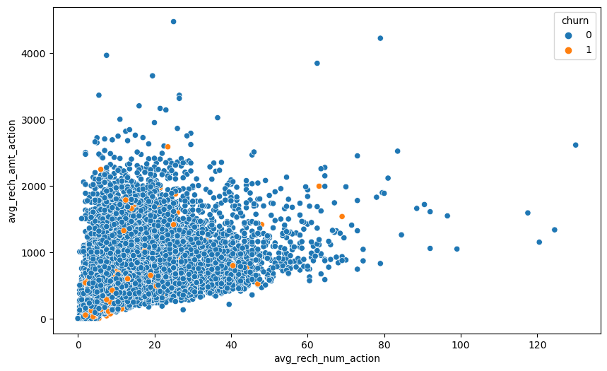
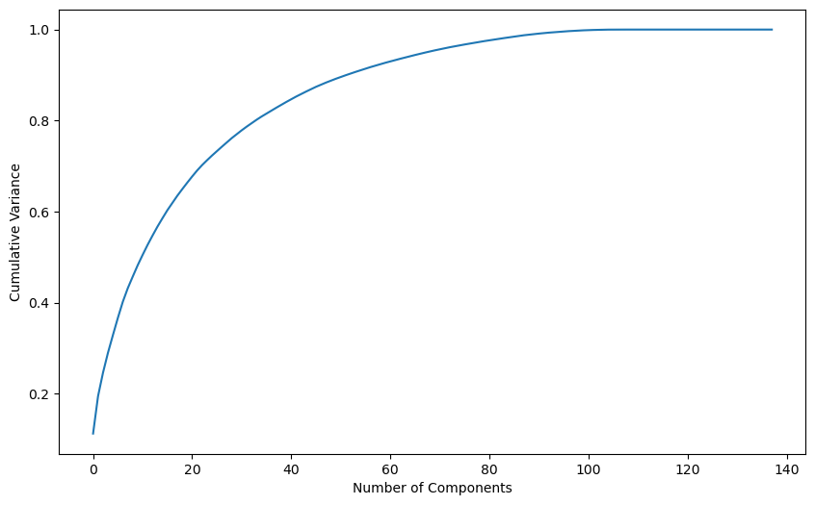
Step 7 : Model Building with PCA

Slide 10
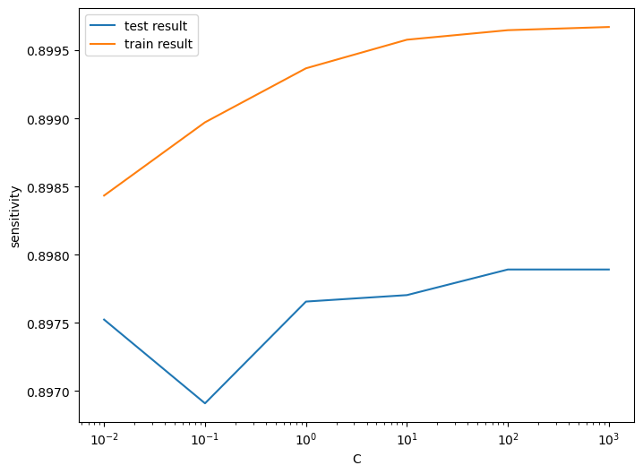
Step 8 : Logistic regression with PCA

Slide 11
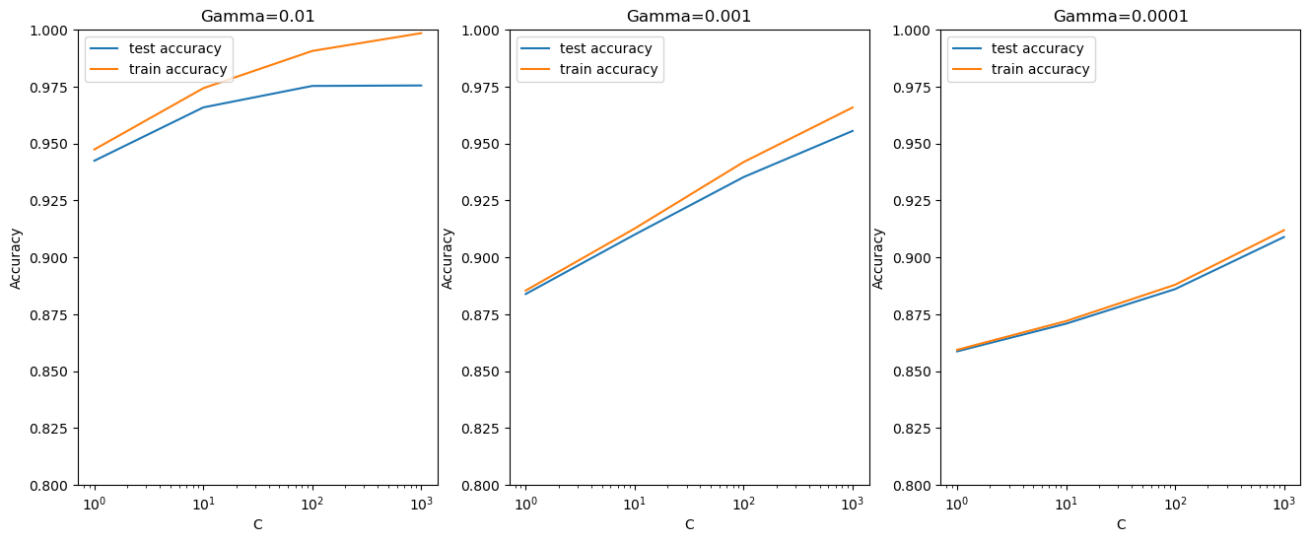
Step 9.2 : Plotting the accuracy with various C and gamma values

Slide 12
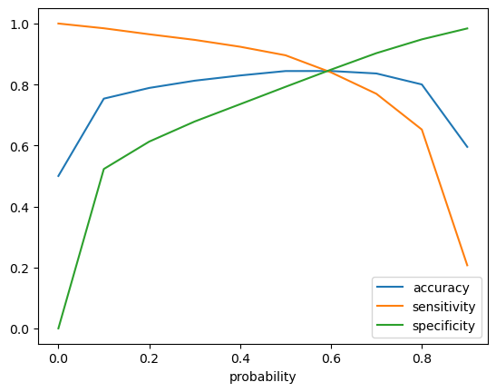
Step 15 : Calculate the accuracy sensitivity and specificity for various probability cutoffs.

Slide 13
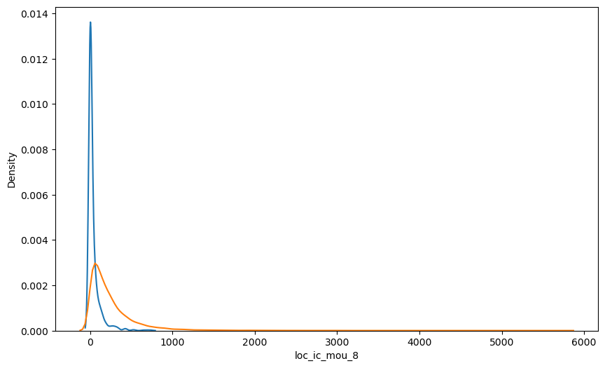
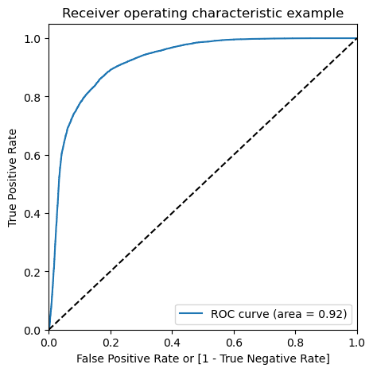
Step 18 : Plots of important predictors for churn and non churn customers

Slide 14
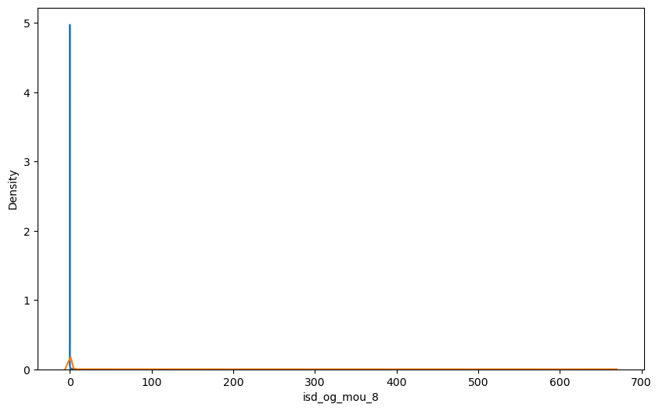

Slide 15
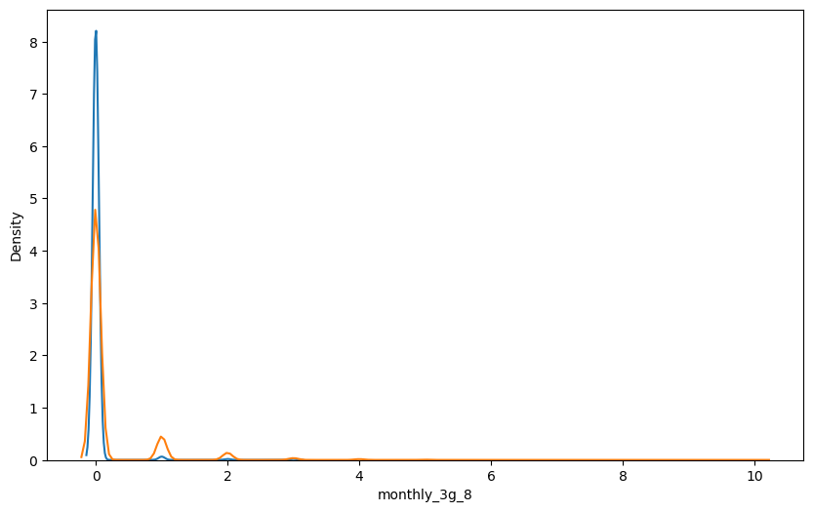

Slide 16
THANK YOU

